Slide 1
Object-oriented training course designing report
Labeled wafer manufacturing data set processing, classification and optimization
College of Mechanical Engineering, Donghua University
Group members: Jie Ren, Cheng Zheng, Qirui Yang, Ziwen Liu
Main Reporters: Jie Ren, Cheng Zheng

Slide 2
Contents
1. Background
Characteristics
Main Research Structure
Block Implementation Steps
Experimental Results

Slide 3
1. Background
Characteristics
Main Research Structure
Block Implementation Steps
Experimental Results

Slide 4
1. Background
Wafer manufacturing belongs to microelectronics industry. its manufacturing technology is usually regarded as one of the standards of national advanced manufacturing technology. Therefore, the pass rate of wafer products plays a very important role in the whole wafer manufacturing process.
In normal conditions, the last step in wafer manufacturing is to test the electrical characteristics of wafer products. Different labels are attached on the products with different grades from testing, for the different kind of customers needs. However, the wafer tester is unstable and has a high misjudgment rate. So the stability of wafer testing has always been one of the main problems in wafer production.
Problem Proposed: with obtained wafer testing data and labels, establishing a model and optimizing it to improve the detection rate of defective wafer products.

Slide 5
1. Background
Characteristics
Main Research Structure
Block Implementation Steps
Experimental Results

Slide 6
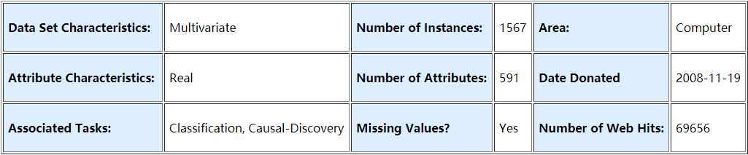
2. Characteristics
Data Set tested by various sensors in wafer manufacturing products testing process
Contains some invalid data
Features are not necessarily useful
Uneven distribution of samples
Clean data
Select useful features
Balancing

Slide 7
1. Background
Characteristics
Main Research Structure
Block Implementation Steps
Experimental Results

Slide 8
3. Main Research Structure
Reading Data Set
Data pre-processing
Pre-screening
Disordered and then processed
balancing
classification&
Evaluation
Getting Result

Slide 9
3. Main Research Structure
Data pre-processing
Pre-screening
Disordered and then processed
balancing
classification&
Evaluation
Initialization parameters
Delete duplicate rows
Remove NaN counts

Slide 10
3. Main Research Structure
Data pre-processing
Pre-screening
Disordered and then processed
balancing
classification&
Evaluation
Feature discretization
Calculate mutual information

Slide 11
3. Main Research Structure
Data pre-processing
Pre-screening
Disordered and then processed
balancing
classification&
Evaluation
Normalized processing
Scrambled order by line
Dividing data sets

Slide 12
3. Main Research Structure
Data pre-processing
Pre-screening
Disordered and then processed
balancing
classification&
Evaluation
Balanced processing
Scrambled order by line

Slide 13
3. Main Research Structure
Data pre-processing
Pre-screening
Disordered and then processed
balancing
classification&
Evaluation
Classifier
Genetic algorithm optimization

Slide 14
1. Background
Characteristics
Main Research Structure
Block Implementation Steps
Experimental Results

Slide 15
4. Block Implementation Steps
Data pre-processing
original_sepecific = original_data.drop_duplicates(keep='first', inplace=False)
Initialization parameters
Delete duplicate lines
Number of rows in the original dataset 591
The number of rows in the dataset after deleting duplicate rows 591
Remove
NaN counts

Slide 16
4. Block Implementation Steps
Data pre-processing
Skip NaN,
Extract original matrix value terms
Generate a new matrix
Initialization parameters
Find the mean value of each column
……
Delete duplicate rows
Find the average value of each column and place it in the corresponding position of the new matrix.
Remove
NaN counts

Slide 17
4. Block Implementation Steps
Pretreatment：X_tezheng = original_clean[:, 0:590]
Discrete method: equal width dispersion
Pre-screening
According to the shape of the feature matrix,
Building an empty matrix
Feature discretization
……
Set the dispersion
parameter k
Calculate mutual information
According to k, the principle of equal width is used to sequentially divide each column of the matrix feature, and convert the original value into a value of 0 to k-1, and put them into the empty matrix.

Slide 18
4. Block Implementation Steps
Pre-screening
Feature discretization
Calculate mutual information

Slide 19
4. Block Implementation Steps
Disordered and then processed
The raw data is linearly transformed so that the results fall within the 0-1 interval.
Normalized processing
Scrambled order by line
One thing should be considered:
if the Denominator equals to 0,
Then the whole value should be taken as 1.
Dividing data sets

Slide 20
4. Block Implementation Steps
Disordered and then processed
np.random.permutation(X_guiyi_result.shape[0])
disorder randomly and remember the 'order'
Normalized processing
arrange the feature column in 'order'
Scrambled order by line
arrange the label column in 'order'
Dividing data sets

Slide 21
4. Block Implementation Steps
Disordered and then processed
Feature training set
Label training set
Normalized processing
Scrambled order by line
941
Feature testing set
Label testing set
Dividing data sets
1254
Feature verification set
Label verification set

Slide 22
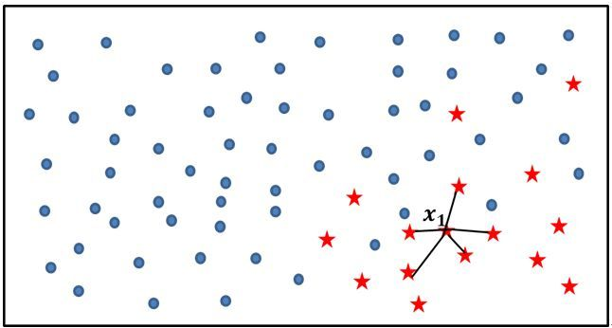
4. Block Implementation Steps
balancing
SMOTE method
Calculate k neighbors in each minority class sample
Balanced processing
Feature training set
Label training set
Feature training set
Label training set
Randomly pick out N neighbors, interpolate between this sample, and generate a new small sample
Scrambled order by line
BEFORE
The new sample is synthesized with the original data to generate a new training set.
AFTER
Training set matrix before balancing (941,100)
Training set labels before balancing (941,)
Training set matrix after balancing (1335,100)
Training set labels after balancing (1335,)

Slide 23

4. Block Implementation Steps
balancing
Balanced processing
BEFORE
Scrambled order by line
AFTER

Slide 24
4. Block Implementation Steps
Data pre-processing
Pre-screening
Disordered and then processed
balancing
classification&
Evaluation
Initialization parameters
Feature discretization
Normalized processing
Balanced processing
Delete duplicate rows
Calculate mutual information
Scrambled order by line
Scrambled order by line
Remove
NaN counts
Dividing data sets
Principle: first review, then re-screen and order
Calculate mutual information before balancing; divide data sets after out of order

Slide 25
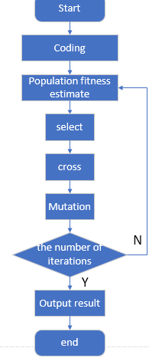

4. Block Implementation Steps

Slide 26
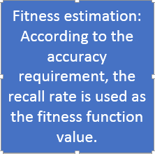
4. Block Implementation Steps

Slide 27
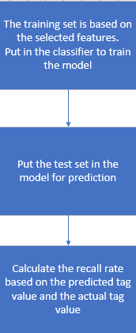
4. Block Implementation Steps

Slide 28
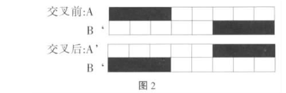
4. Block Implementation Steps
Use the tournament selection method to select the parent to iterate
twopoint crossover
Using flip mutation

Slide 29
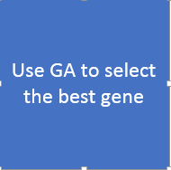
4. Block Implementation Steps

Slide 30
1. Background
Characteristics
Main Research Structure
Block Implementation Steps
Experimental Results

Slide 31
5. Experimental Results
 | Relevant, positive kind | Non Relevant, negative kind
Retrieved | TP | FP
Not Retrieved | FN | TN

Slide 32
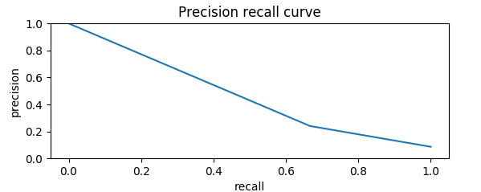
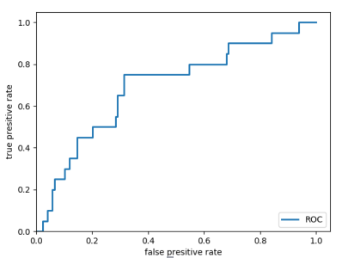
5. Experimental Results
PR curve
ROC curve

Slide 33
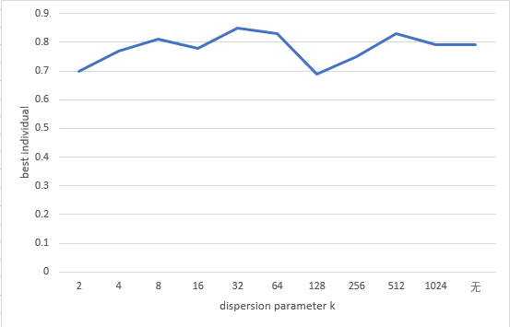
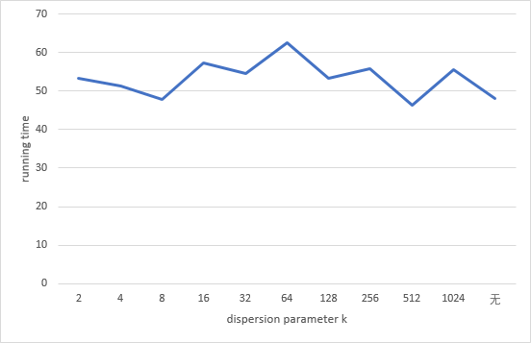
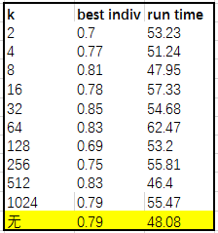
5. Experimental Results
Influence of different dispersion coefficients on recall rate
(single experiment)
Influence of different dispersion coefficients on running time
(single experiment)

Slide 34
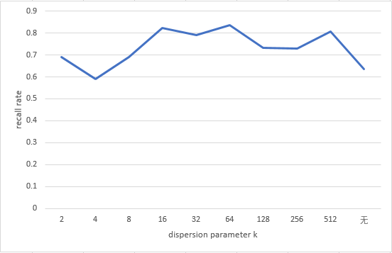
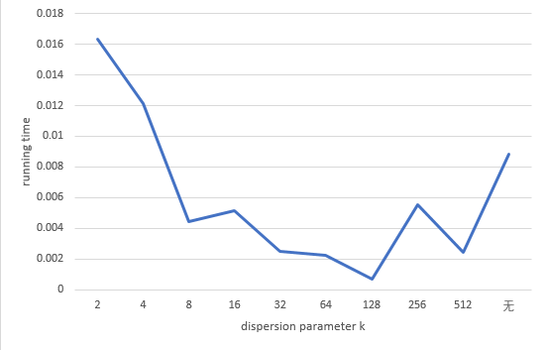
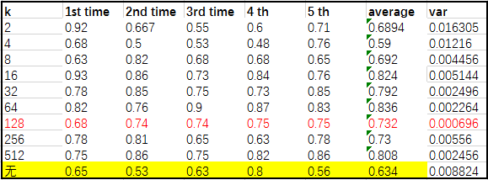
5. Experimental Results
Influence of different dispersion coefficients on recall rate
(single experiment)
Influence of different dispersion coefficients on running time
(single experiment)

Slide 35
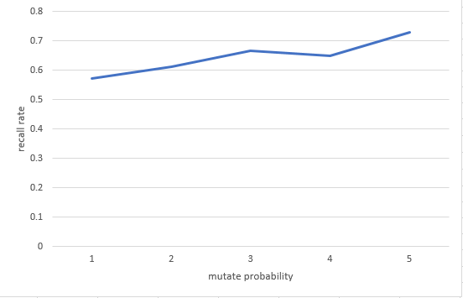
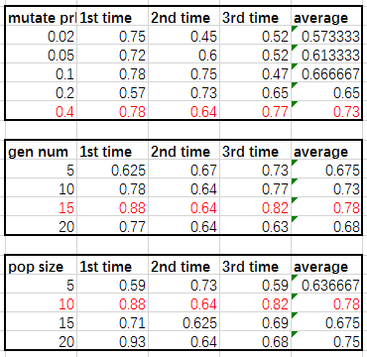
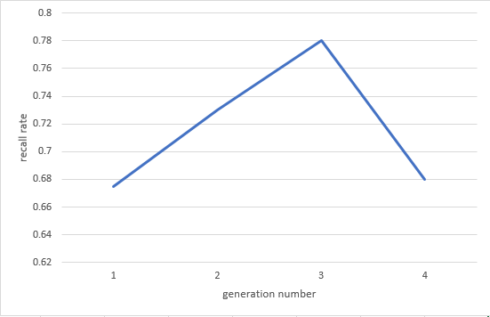
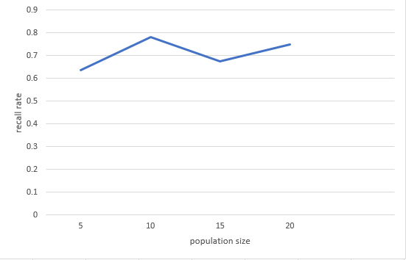
5. Experimental Results
mutation rate, genetic algebra, population size, effect on recall rate (mean value of three experiments)

Slide 36
5. Experimental Results
Parameters selection ：
Population number 10 Generation number15 Crossover rate0.8 Mutate rate0.4
Current highest recall rate : 0.82
Column of the most influential testing results:
5, 42, 49, 141, 189, 190, 191, 193, 194, 226, 229, 230, 232, 234, 236, 237, 241, 242, 243, 256, 257, 259, 260, 262, 264, 265, 284, 313, 314, 315, 322, 327, 328, 329, 364, 372, 374, 379, 394, 402, 414, 451, 458, 464, 498, 501, 502, 503, 504
The repeated character columns in the result after calculating 3 times ：
42, 49, 189, 226, 230, 259, 262, 265, 322, 327, 372, 451, 464

Slide 37
The general division of labor in the course design:
Coding: Jie Ren, Cheng Zheng, Qirui Yang
Debugging: Jie Ren, Cheng Zheng, Qirui Yang
PowerPoint: Cheng Zheng, Ziwen Liu, Jie Ren
Verification: Zheng Cheng, Liu Ziwen, Ren Jie

Slide 38
Thank you Sincerely
Thank you for watching!

